Slide 1




VII
Department of Electronics and Telecommunications
T
Presentation on
Airline Satisfaction Prediction
By
Roshan Jadhav-311066-22220205
Aman Kumar-311013-22110559
Shruti Gangurde-311015-22110848
Rajesh Kamble-311023-22110316
Subject: Machine Learning
Guided by:
Yogesh Dandawate Sir
Department of Electronics and Telecommunications
Vishwakarma Institute of Information Technology, Pune

Slide 2



VII T
Department of Electronics and Telecommunications
Outline
Introduction
Motivation
Literature Survey
Objectives
Methodology
Dataset
Implementation
Different Phases of Implementation (if any)
Results
Conclusions
References

Slide 3
VII T
Department of Electronics and Telecommunications
Introduction
In an era where air travel has become an integral part of Global connectivity, Understanding and Improving passenger satisfaction is crucial for the airline industry.
The primary objective of this mini project is to develop predictive model that can assess and predict passenger satisfaction levels. By utilizing a dataset containing information about flight details customer demographics, and flight details, customer demographics, and feedback ,we aim to train a machine learning model that can accurately classify customer satisfaction as positive way.
With the help of various python libraries based machine learning tools we are going to analyse and train the data.

Slide 4
Department of Electronics and Telecommunications
Then we'll make an attempt to build a machine learning model based on our information. The ML model will help us to predict whether a passenger is satisfied with the airline service or not.
Steps we're going to follow-
Defining Problem
Briefing about Data
Importing Data from libraries
Data Exploration
Data Summarization
Modelling
Experimentation & Evaluation
Airline Satisfaction prediction

Slide 5
VII T
Department of Electronics and Telecommunications
Motivation
Operational Improvements: Airlines can use the model to identify areas of dissatisfaction, such as specific flight routes or times, allowing them to make operational adjustments to enhance the overall travel experience.
Customer Service Enhancement: By predicting dissatisfaction factors, airlines can proactively address issues, improve customer service, and reduce the likelihood of negative experiences.
Fleet Management: Identifying dissatisfaction trends related to specific aircraft or amenities can guide decisions on fleet upgrades, ensuring that customer expectations are met or exceeded.
Loyalty Program Optimization: Predicting satisfaction can aid in refining loyalty programs. Offering rewards or incentives tied to factors that influence satisfaction may increase customer loyalty.
Investor Relations: Airlines can utilize satisfaction predictions to communicate proactively with investors, showcasing efforts to address concerns and improve the customer experience.
Predictive Maintenance: If satisfaction is affected by technical issues, predictive maintenance based on historical data can help prevent disruptions and enhance overall passenger experience.
Partnership Selection: Understanding how partnerships impact satisfaction can influence decisions regarding code-sharing agreements, alliances, and collaborations with other service providers.

Slide 6
VII T
Department of Electronics and Telecommunications
Literature Survey
Paper/Article | Key Findings
Predicting Airline Passenger Satisfaction with Classification Algorithms. | This study uses several classification models such as KNN, Logistic Regression, Gaussian NB, Decision Trees and Random Forest which will later be compared.
Forecast and analysis of aircraft passenger satisfaction based on RF-RFE-LR model. | combined with the logistic model, the factors affecting customer satisfaction are further extracted. The experimental results show that the RF-RFE model selects a feature subset containing 17 variables.
Business Intelligence in Airline Passenger Satisfaction Study | The main objective and contribution of this paper is the application of our knowledge discovery business-intelligence technique (fuzzy rule-based classification systems) characterized by genetically optimized interpretability-accuracy trade-off (using multi-objective evolutionary optimization algorithms) to decision support related to airline passenger satisfaction problems.

Slide 7
VII T
Department of Electronics and Telecommunications
Objectives or Aim
1)Predicting passenger satisfaction
Develop machine learning models to accurately predict levels of satisfaction based on various faction.
2)Identifying key factors
Determine the key factor that significantly influence passenger satisfaction , such as in flight services punctuality and customer interactions.
3)Operation insights
Gain insights into operational aspects that impact satisfaction, allowing airlines to optimize resources and improve overall efficiency.
4)Enhancing Brand Reputation
1)Utilize predictive analytics to improve overall brand reputation by consistently
Delivering positive customer experiences.
5)Strategic positioning
Strategically position airlines to be responsive to emerging trends and challenges, ensuring long-term success in the industry

Slide 8
VII T
Department of Electronics and Telecommunications
Methodology
1)Defining problem
Given the airline passenger satisfaction survey information about the passenger can we predict weather they are satisfies or not with airline services? Also what factors are they correlated to a satisfied
2)Briefing about data
what does this data contains?
The airline passenger satisfaction folder comes with one csv files.
Airline.csv
This data set contain attributes about airline services
3)Where do we get the data from
we got data from Kaggle
4)What information do we get from this data ??
their information
5)Importing data
In this section we are going to import our basic required files and modules which need exploratory data Analysis and further data processing
6)Modules are going to use
pandas, NumPy, matplotlib

Slide 9
Department of Electronics and Telecommunications
7)Importing Datasets
Before Importing the dataset we have to download the available data from from the source,
for our case its Kaggle dataset.
1)We can directly download it with the help of open dataset module and load it with the o module.
2)Or we can directly download the data offline and load it with pandas module
8)Data Exploration
In this section we are going to explore and get useful insights about our dataset. By exploring
the distributions of various columns we can see how they are related to target column
9)General Information about dataset
Dataset value
Column information
Statistical information
Unique value
Airline Satisfaction prediction

Slide 10
Feature
1)Selection After encoding the model, I wanted to immediately conduct feature selection — not just so that my model would run efficiently but also so that the models themselves had less dimensionality to reduce noise and possible overfitting.
2) models are used in this project to check for maximum efficiency. They are,
Logistic Regression
Naive Bayes
KNN
Decision Tree
Neural Network
Random Forest
Airline Satisfaction prediction

Slide 11
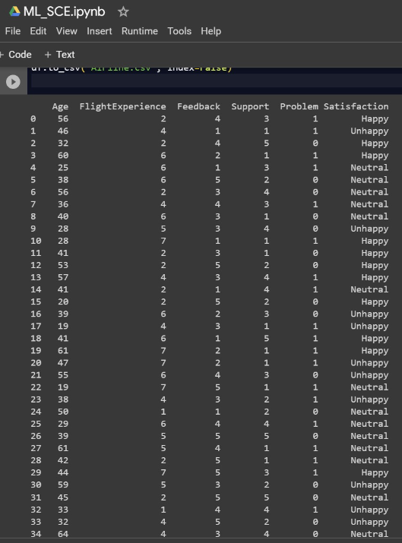
VII T
Department of Electronics and Telecommunications
Dataset used
DATASET USED
Key drivers of airline loyalty
Sara Dolnicar, Klaus Grabler, Bettina Grun, Anna Kulniq
An investigation of service quality, customer satisfaction and loyalty in China's airline market
Hongwei Jiang, Yahua Zhang
Airline Passenger Satisfaction
Marian B. Gorzałczany , Filip Rudzi ´nski and Jakub Piekoszewski

Slide 12
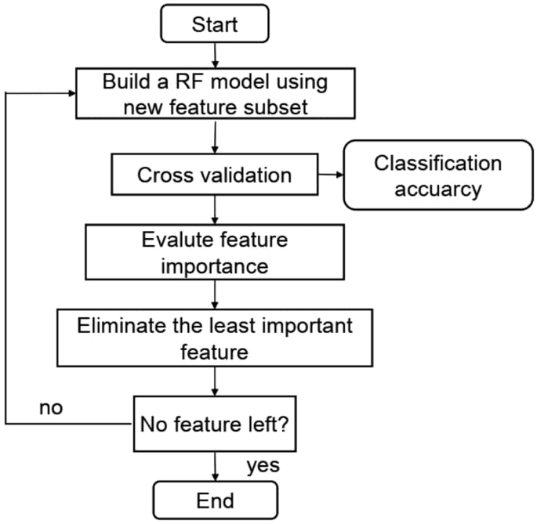

Slide 13
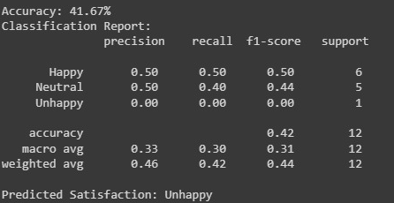
VII T
Department of Electronics and Telecommunications
Results

Slide 14
VII T
Department of Electronics and Telecommunications
Conclusion
We would be able to confidently present to the client that we have data-informed recommendations on where they can improve their customer service, evidenced by an interpretable XG Boost machine-learning pipeline that exhibits high accuracy and high precision.
To summarize, it’s very crucial to focus on how efficiently passengers get on the plane, and how they’re treated while on board.There is a fundamental difference in satisfaction given how customers react to certain service qualities given their reason for traveling.
Most important among these service aspects is the quality of in-flight Wi-Fi service on board. Regardless of cabin or travel purpose, high marks in Wi-Fi capabilities are a huge opportunity for increasing customer satisfaction and expanding competitive advantage.

Slide 15
VII T
Department of Electronics and Telecommunications
References
Airline Passenger Satisfaction Dataset (Kaggle):https://www.kaggle.com/datasets/teejmahal20/airline-passenger-satisfactionExample
https://r.search.yahoo.com/_ylt=Awr1QSuBa2ll.VEGqKy7HAx.;_ylu=Y29sbwNzZzMEcG9zAzQEdnRpZAMEc2VjA3Ny/RV=2/RE=1701436418/RO=10/RU=https%3a%2f%2fwww.researchgate.net%2fpublication%2f372066077_AIRLINE_PASSENGER_SATISFACTION_PREDICTION_USING_MACHINE_LEARNING_ALGORITHMS/RK=2/RS=pMKGWHiGZ4QnvZW7rISmZhtgDZs-
https://github.com/chrisbacani/Udacity-Data-Scientist-Capstone
https://r.search.yahoo.com/_ylt=Awr1QSuBa2ll.VEGqqy7HAx.;_ylu=Y29sbwNzZzMEcG9zAzYEdnRpZAMEc2VjA3Ny/RV=2/RE=1701436418/RO=10/RU=https%3a%2f%2fwww.researchgate.net%2fpublication%2f344665517_A_STUDY_ON_SERVICE_QUALITY_AND_PASSENGER_SATISFACTION_ON_AIRLINES/RK=2/RS=TFAGra9anjZHMwtkCIRdrtKA6NU-

Slide 16
VII T
Department of Electronics and Telecommunications
THANK YOU

